Slide 1
Organigram of TRENZ AG
Stand 10.12.2014
Executive
CEO
Finance / Human Resources
Frank Diegel
CEO
Product Developer
Stefan Gerdts
Division Administration
Division Administration
Executive Assistant
Accounting / Office Management
Katharina Bündgen
Receptionist
Anke Randecker
Operations
Maritime
Products
General Manager Maritime
Attorney
Stephan Piworus
Director of Products
Sören Kuklau
Project Manager / Developer
Olaf Struß
Project Manager / Developer
Head Trainee
Sarah Hennig
Developer
Eray Cakal
Project Manager
Matthias Over
Business Development
Developer
Daniel Marner
Systems Coordinator
Developer
Frank Kuchta
Business Development Manager
Nataša Miletković
Developer
Carsten Ellieroth
Trainee
Tobias Gold
Trainee
Philipp Kische
Student Assistant
Adrian Drechsel

Slide 2
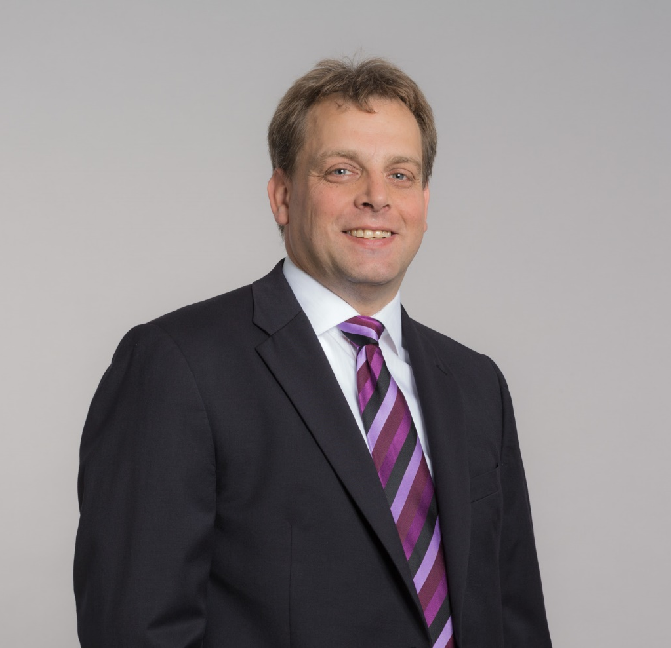
Stefan Gerdts

Slide 3
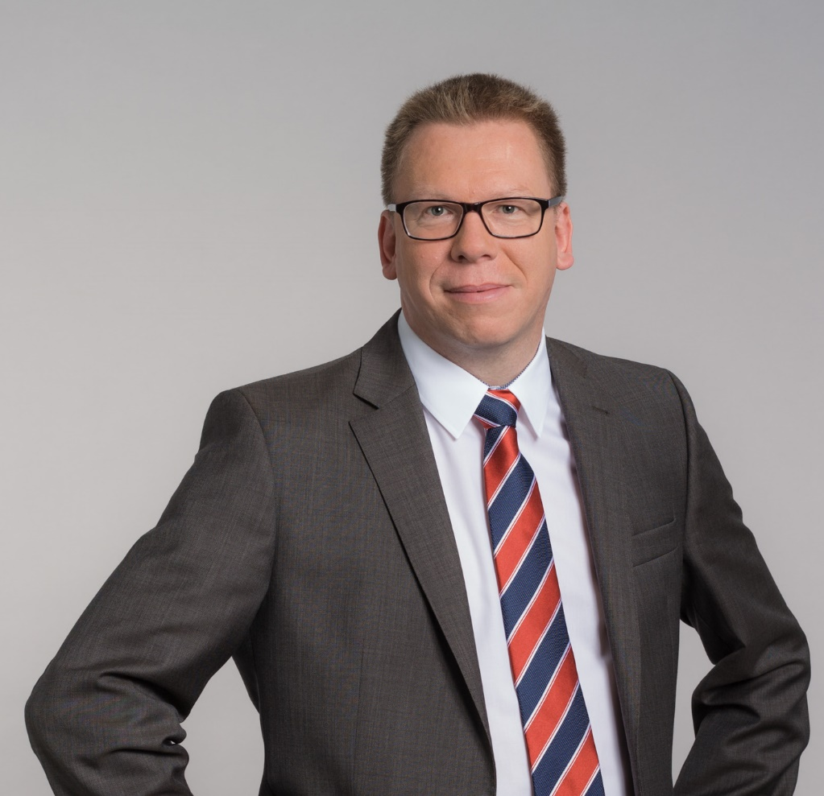
Frank Diegel

Slide 4
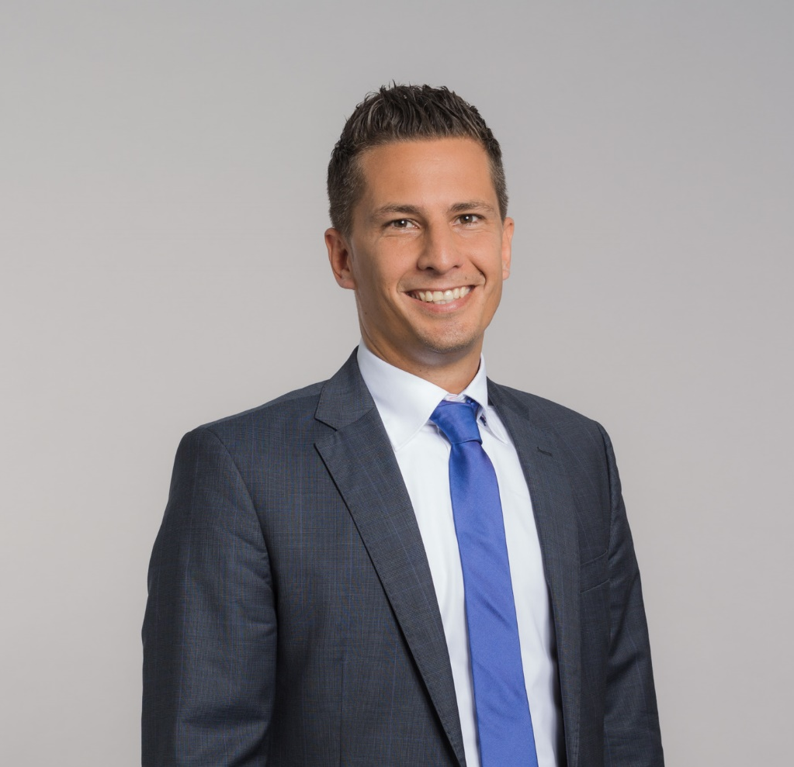
Stephan Piworus

Slide 5
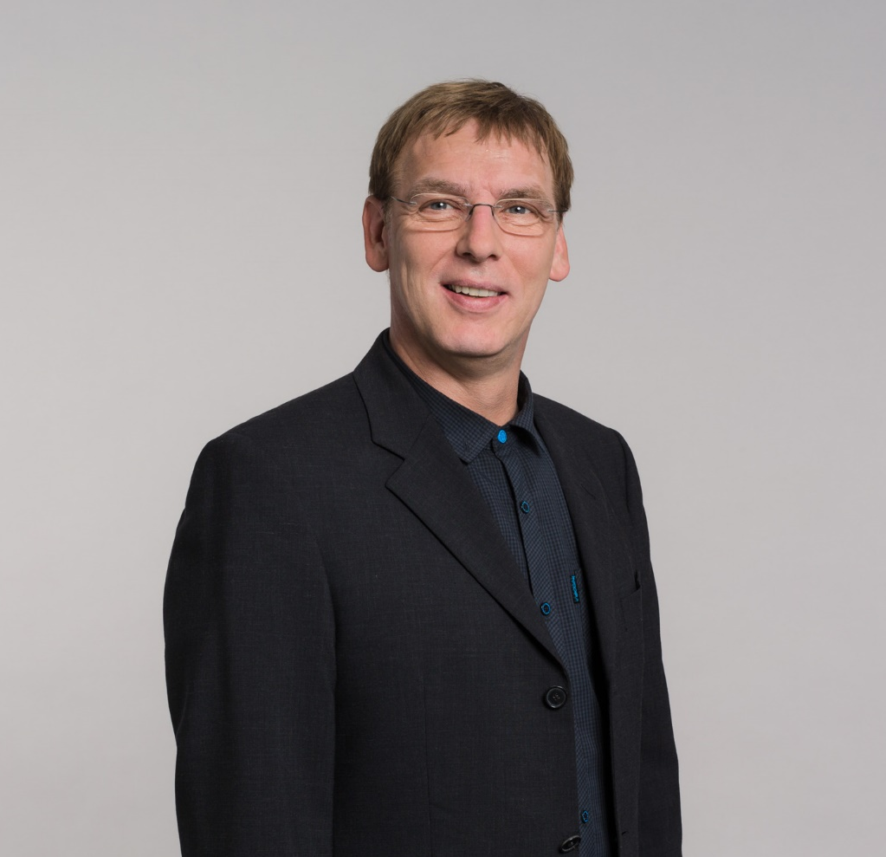
Matthias Over

Slide 6
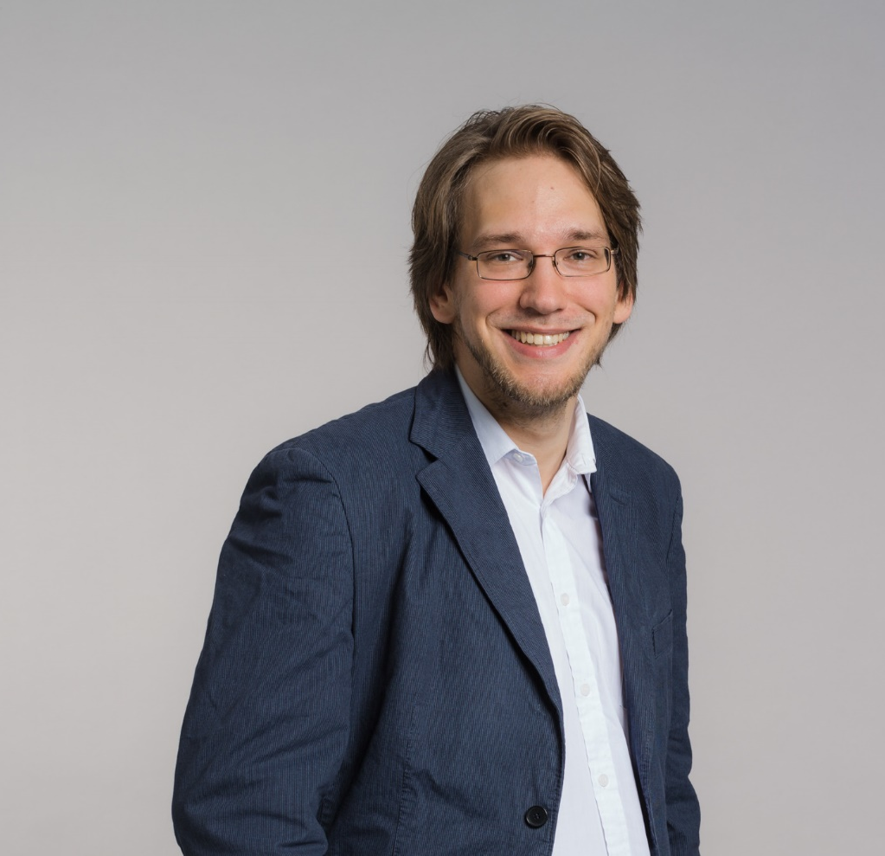
Sören Kuklau

Slide 7
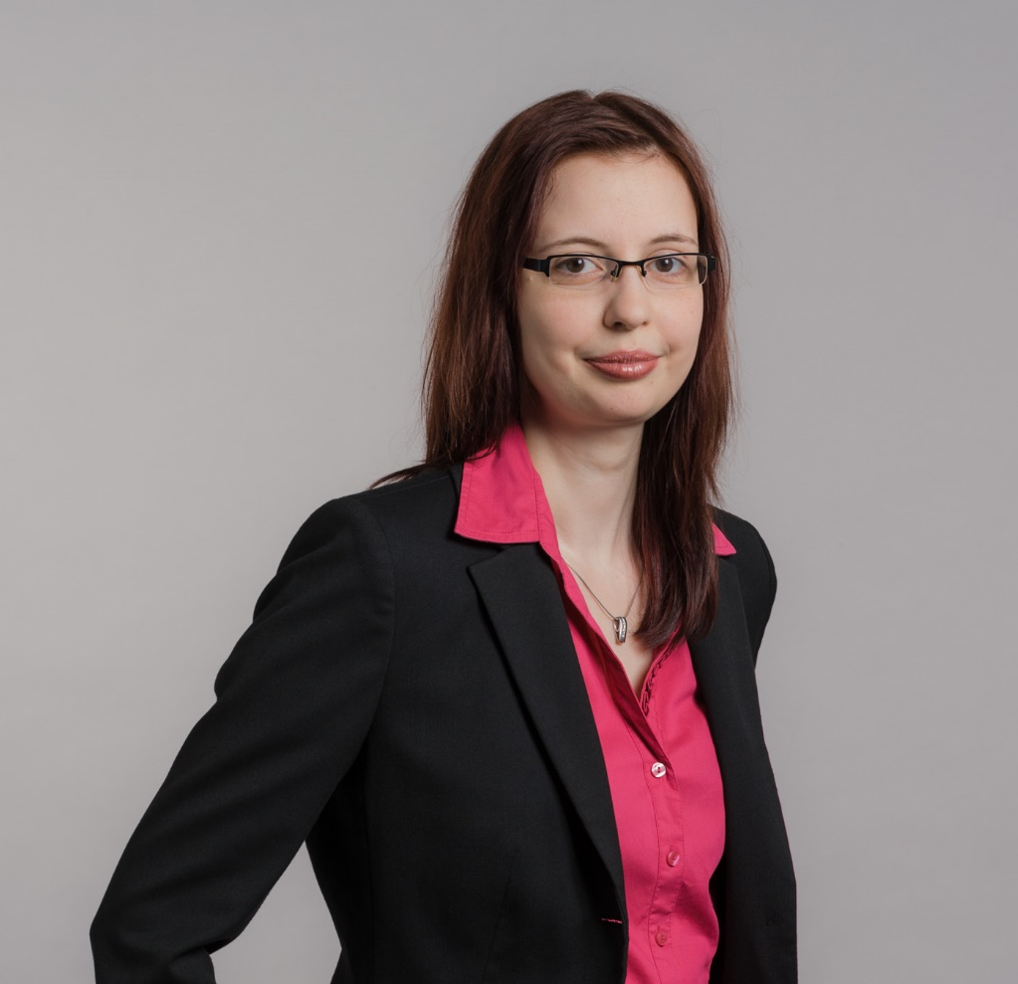
Sarah Hennig

Slide 8
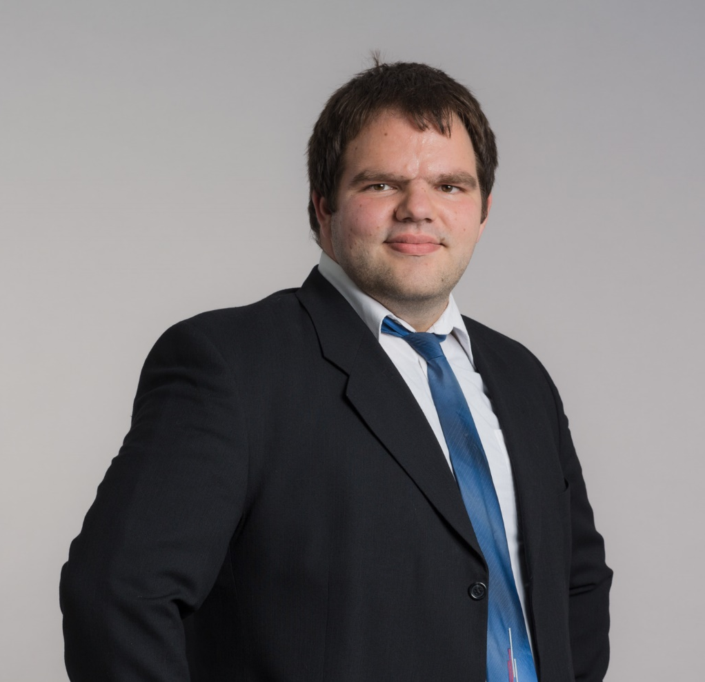
Carsten Ellienroth

Slide 9
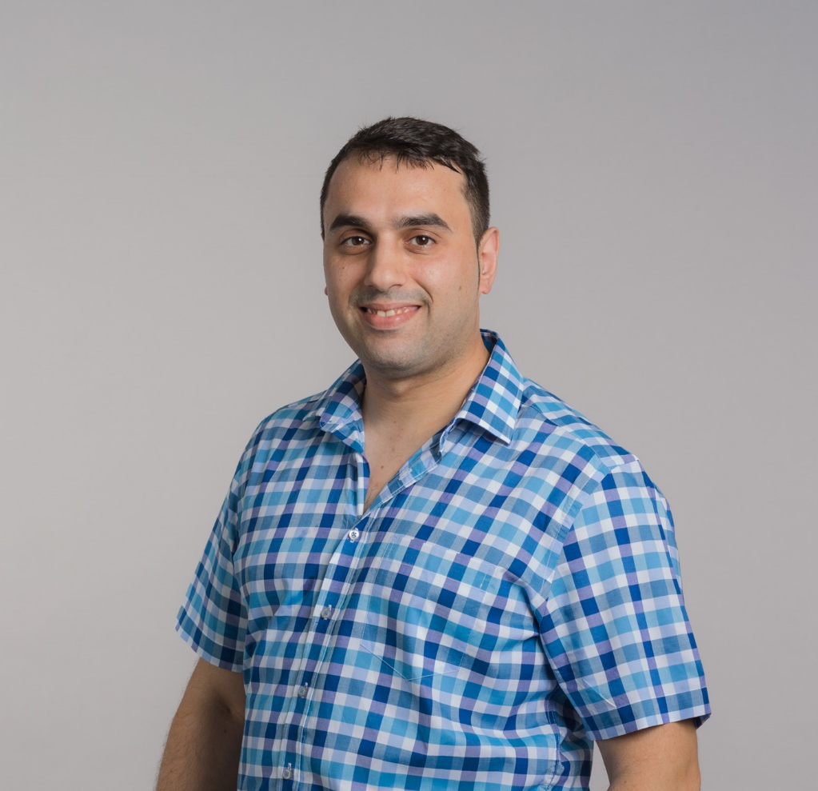
Eray Cakal

Slide 10

Daniel Marner

Slide 11
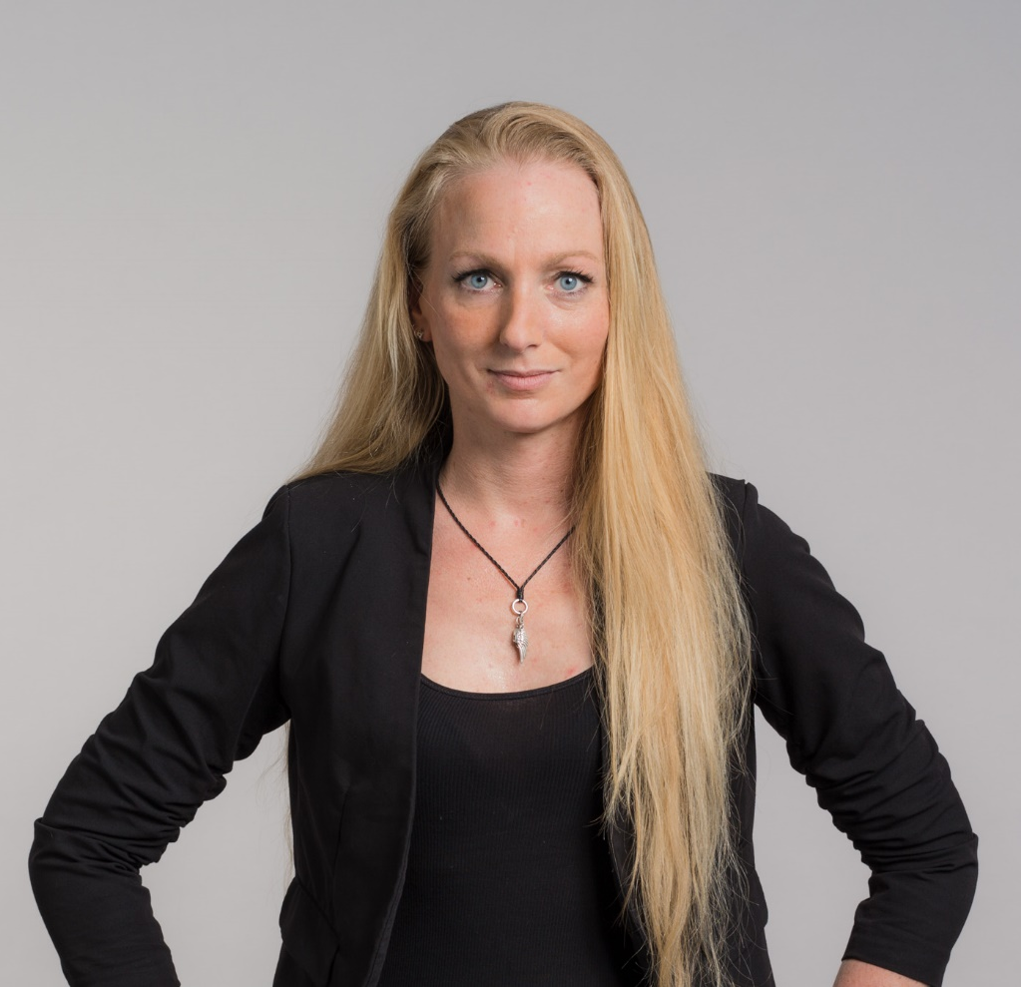
Sina Baasch

Slide 12
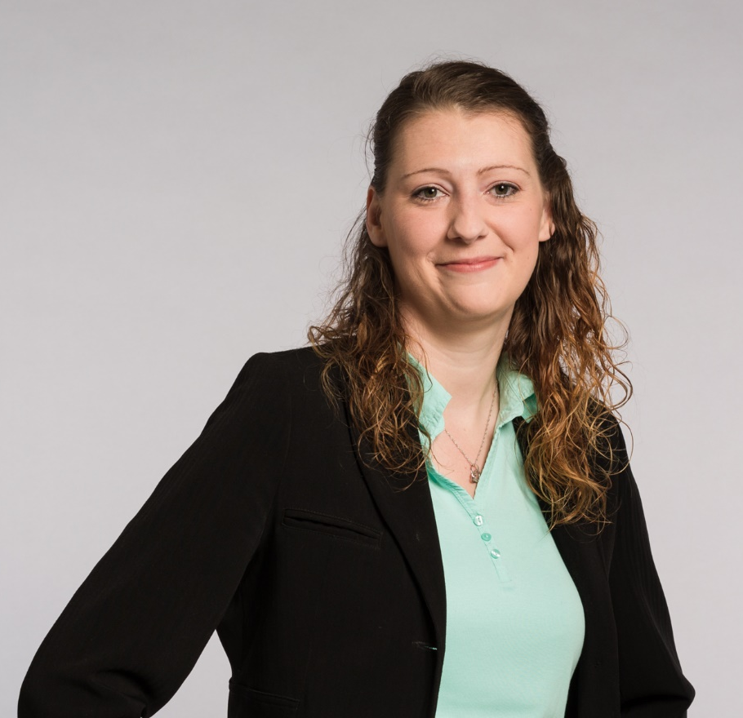
Katharina Cornelius

Slide 13
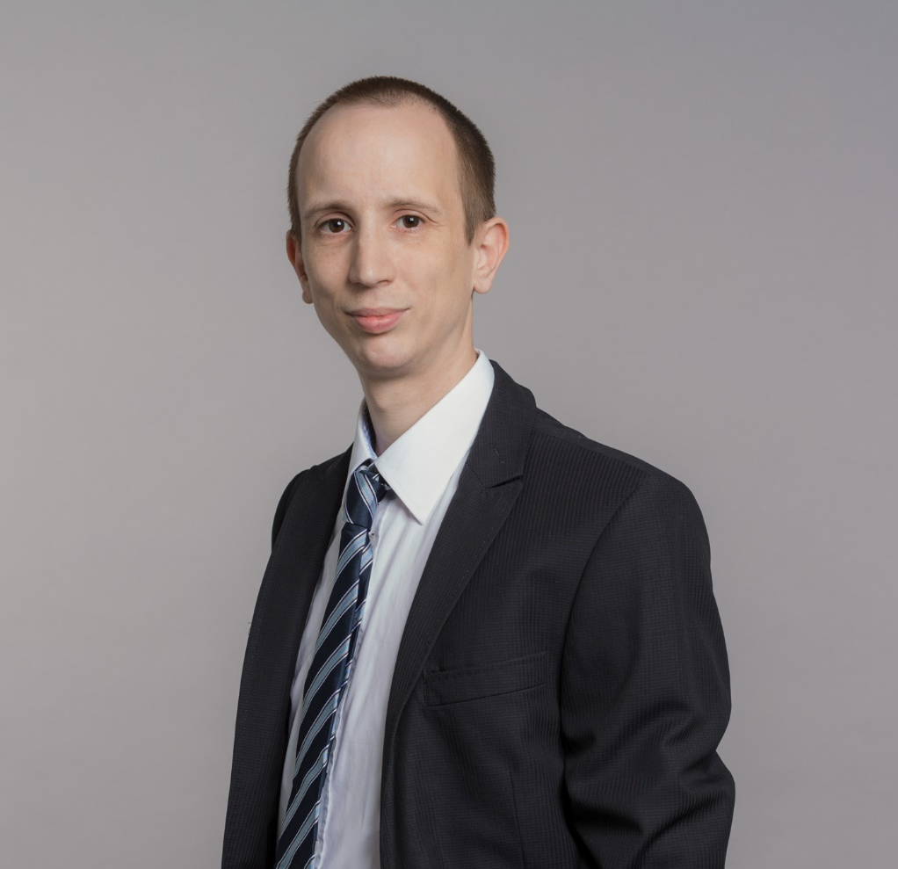
Frank Kuchta

Slide 14
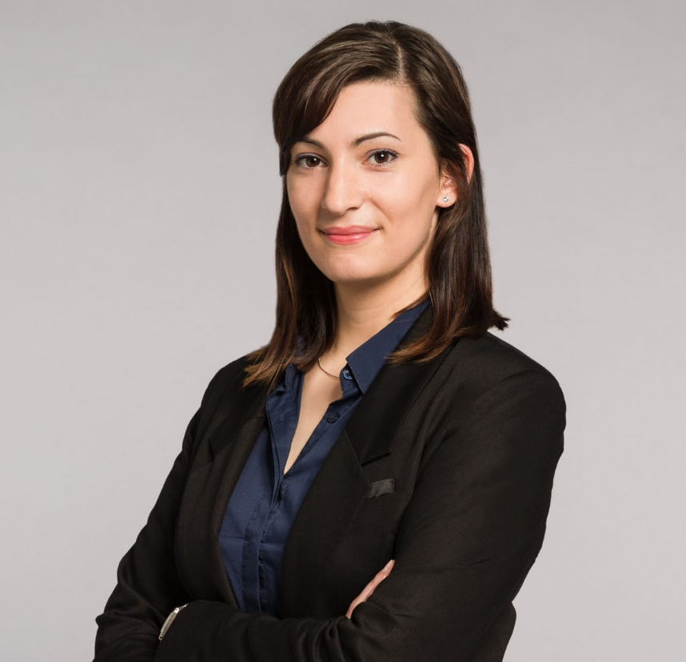
Nataša Miletković

